Slide 1

NDMA C-UAS Operators
VMS Extended System Operation 2

Slide 2
Ext VMS Operation – Admin Menus
In this section of the training we will cover the following:
Accessing Admin Menus
Content Of Subsystems menu
Content of Location Menu
Content of Controller Menu

Slide 3
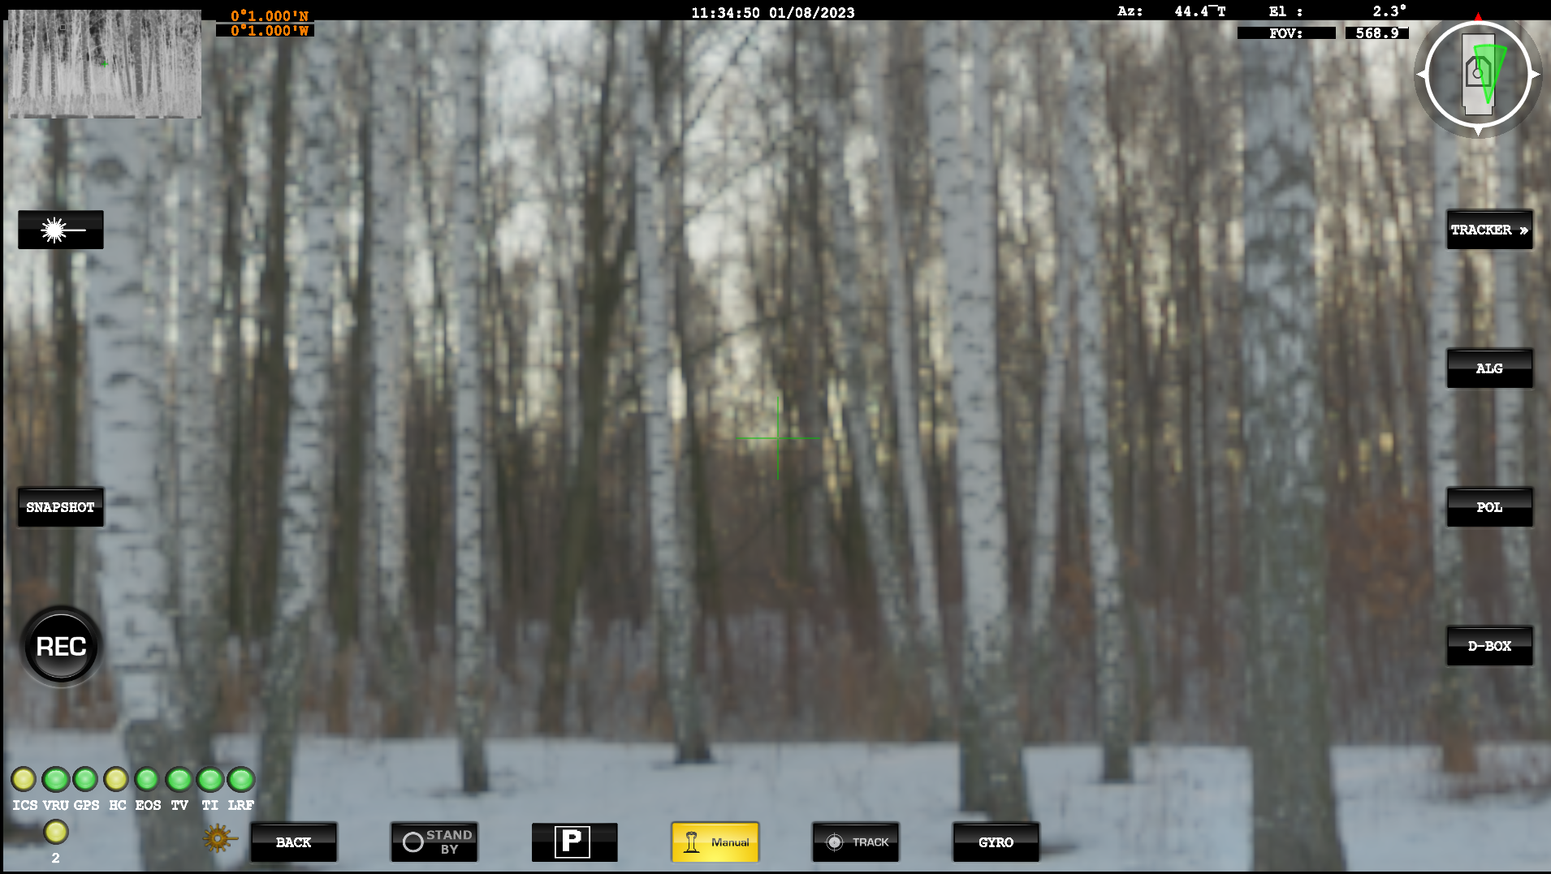
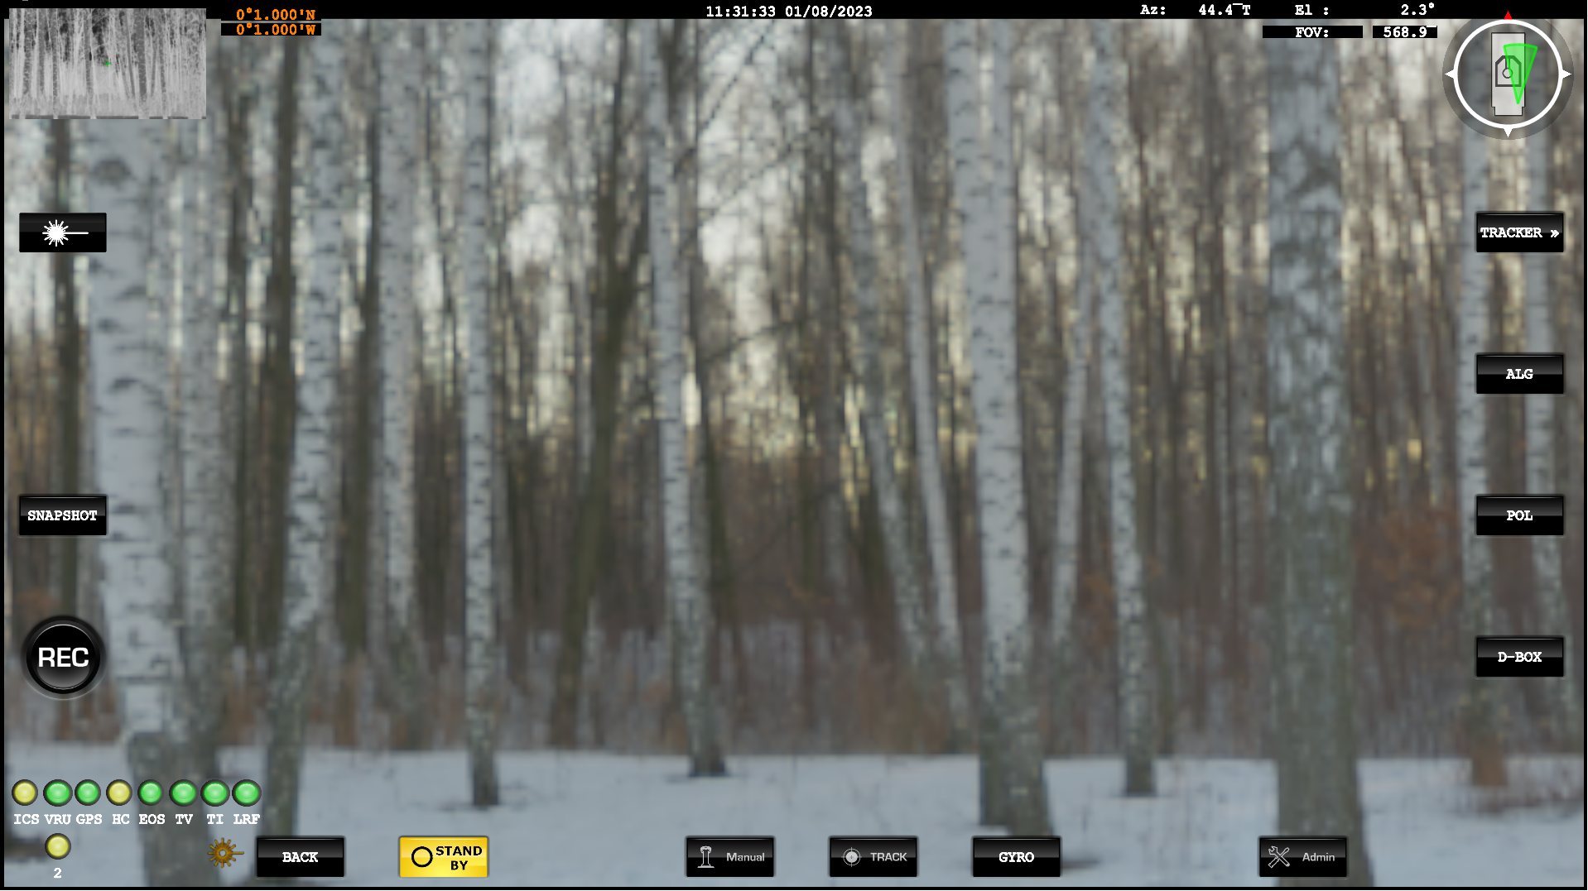
Ext VMS Operation – Admin Menus
Admin Menus are only accessible when the system is in Standby Mode
Notes:
Showing that Admin menus are not available when in Manual mode.
Admin option comes up when in Standby.

Slide 4

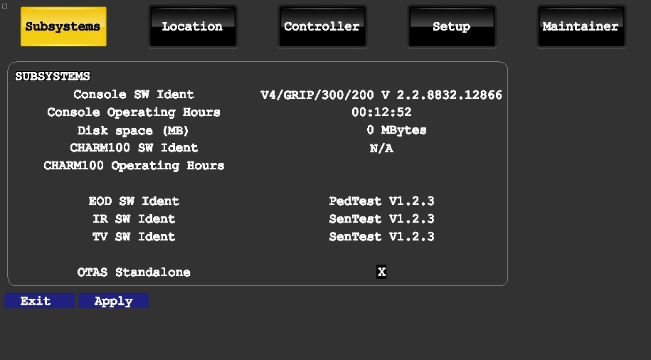
Ext VMS Operation – Admin – Subsystems Menu
This menu details information about the system.
If Reporting Issues or Faults, then please ensure this information is included.

Slide 5
Ext VMS Operation – Admin – Subsystems Menu
Parameter | Description
Console SW Ident | Software part and version number.
Console operating hours | Number of hours since the system was rebooted.
Disk space | Available space on hard disk for recording (MB).
CHARM100 SW Ident | PJB Charm100 software part and version number.
CHARM100 operating hours | Total number of operating hours for the PJB Charm100.
EOD SW Ident | Version number of the software library used to communicate with the EOD.
IR SW Ident | Version number of software library used to communicate with the TI.
TV SW Ident | TV software part and version number.
OTAS standalone | Not required for this system

Slide 6
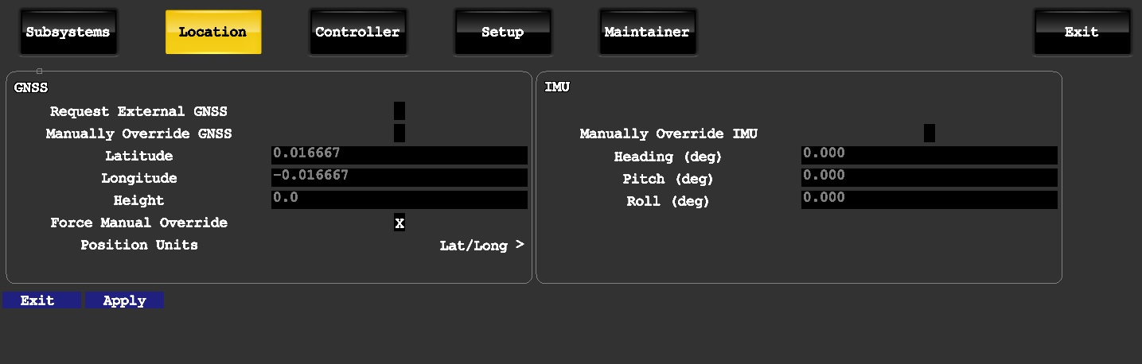
Ext VMS Operation – Admin – Location Menu - IMU
This menu does not need to be utilised, as information will be overwritten by the Chess C2.

Slide 7
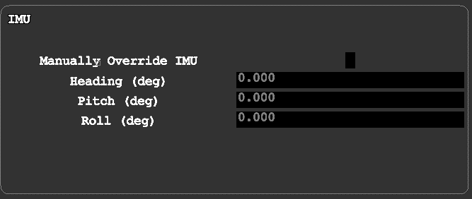
Ext VMS Operation – Admin – Location Menu - IMU
Parameter | Description
Manually override IMU | If checked, a manually entered IMU value will override the heading reported by the IMU.
Manual heading (deg) | Specifies the current heading angle of the EOD (in degrees 0 - 360) to use if overriding the IMU.
Manual pitch (deg) | Specifies the current pitch angle of the EOD (in degrees 0 - 360) to use if overriding the IMU.
Manual roll (deg) | Specifies the current roll angle of the EOD (in degrees 0 - 360) to use if overriding the IMU.

Slide 8
Ext VMS Operation – Admin – Location Menu - GNSS
The Location Menu allows the operator to Manually override Location information supplied by the GNSS.
There is also a selection on the units to be utilised.

Slide 9
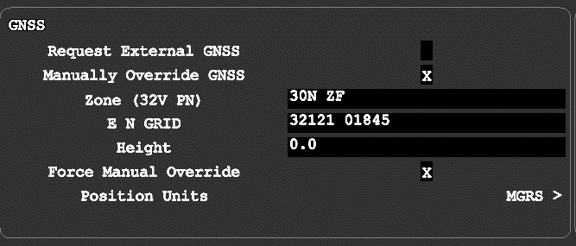
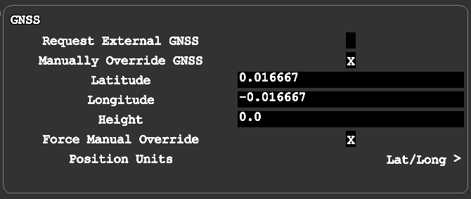
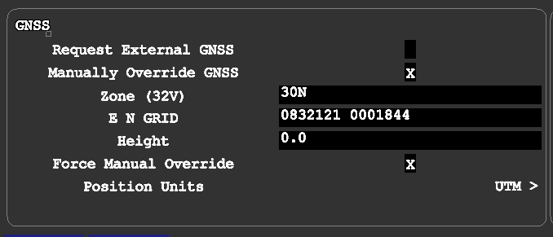
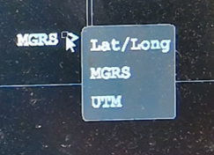
Ext VMS Operation – Admin – Location Menu - GNSS
The Location Menu allows the operator to Manually override Location information supplied by the GNSS.
This can show units in MGRS, LAT/Long and UTM
Notes:
UTM: Universal Transverse Mercator

Slide 10
Ext VMS Operation – Admin – Location Menu - GNSS
Parameter | Description
Request external GNSS | When checked, OTAS will use an external GNSS position, for example from the CV90 GNSS. NOTE: This feature is not available when OTAS is operating in standalone mode.
Manually override GNSS | If checked, a manually entered GPS value will override the heading reported by the GPS. NOTE: Whilst overriding GPS position, the GPS labels on the main screen will appear in orange.
Notes:
UTM: Universal Transverse Mercator

Slide 11
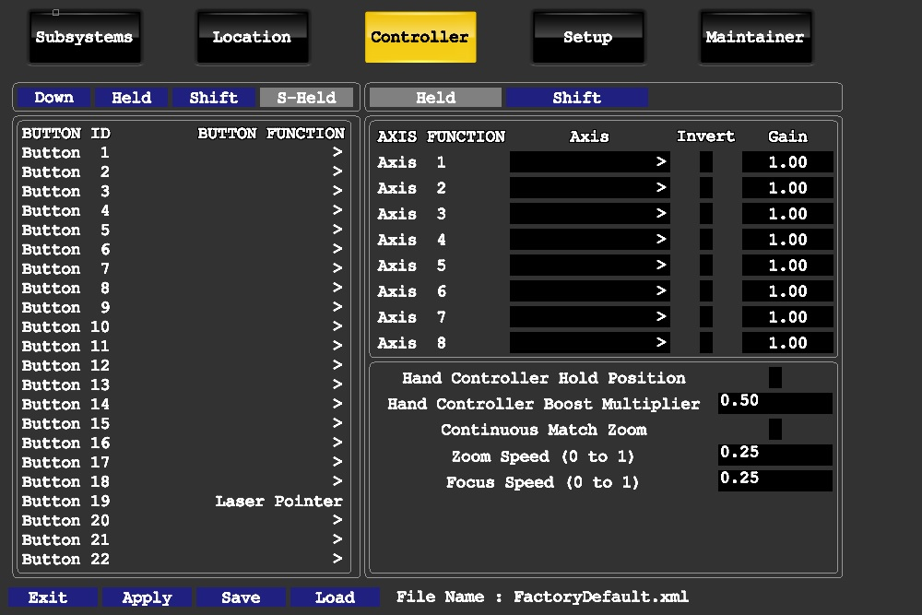
Ext VMS Operation – Admin - Controller
The Controller screen allows you to assign the hand controller buttons to functions and configure the X and Y gain values and the zoom and focus speeds.
It is possible to temporarily change controller assignments.
It is not possible for a standard user to Save or Load.
Maintainer Privileges required to do this.
Notes:
We will look at the individual sections in more detail in the coming slides.

Slide 12
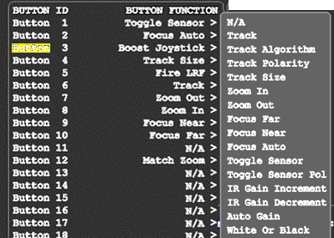
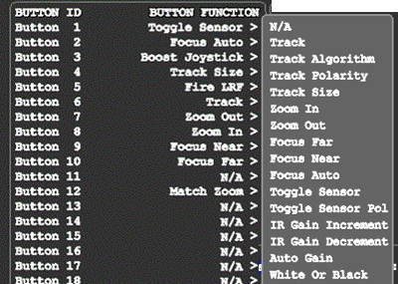
Ext VMS Operation – Admin - Controller
If you press a button on the hand controller, it will highlight the button being pressed in the menu
Click the arrow in the Button Function column, and a drop-down list of the available button functions will appear

Slide 13
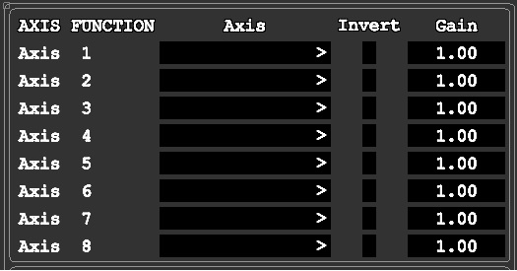
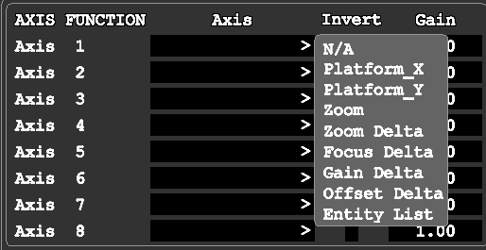
Ext VMS Operation – Admin - Controller
The Axis work in the same way as the buttons.
Selecting an Axis on the Hand Controller will show in the menu.
Controller Gains can be Increased/Decreased depending on the user requirements.
E.g. The Lower the Gain the slower the movement.
It is possible to Invert the Axis
Selecting the Arrow will give a list of possible functions.

Slide 14
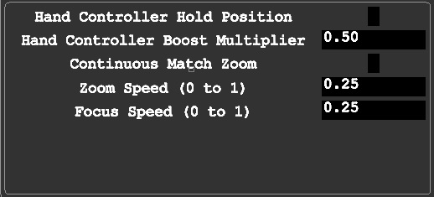
Ext VMS Operation – Admin - Controller
Hold Position.
If enabled, the EOD will hold inertial position when the controller is released.
Boost Multiplier
This is how much the “boost” increases movement of the system.
Continuous Match Zoom
If enabled the sensors will match zoom levels.
Zoom and Focus Speeds
Specifies the Zoom and Focus speeds of the Cameras. (0 to 1)

Slide 15

Ext VMS Operation – Status – Bit Displays
With the Status Indicators, there is additional information available on the subsystems.
Most of these shows a status and some have additional settings

Slide 16
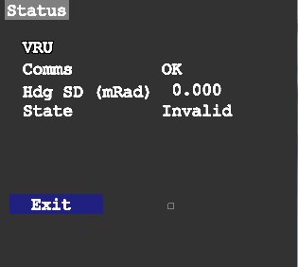
Ext VMS Operation – Status – Bit Displays
VRU
Shows the communications status
Current Heading information
State, whether the information is deemed valid or invalid.

Slide 17
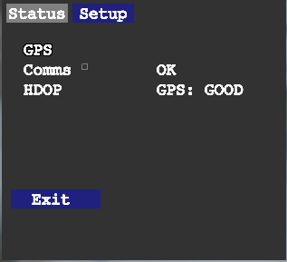
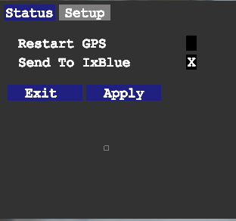
Ext VMS Operation – Status – Bit Displays
GPS - Status
There is status information where communications status is shown and the signal status
GPS - Setup
Not applicable in C-UAS

Slide 18
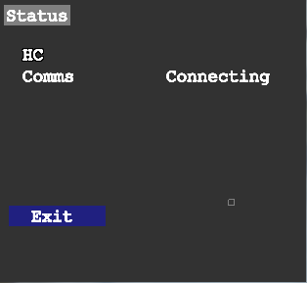
Ext VMS Operation – Status – Bit Displays
HC – Hand Controller
Shows status of connection

Slide 19
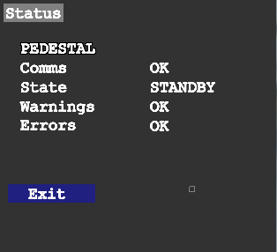
Ext VMS Operation – Status – Bit Displays
EOS
Shows the status of the Viper EOD

Slide 20
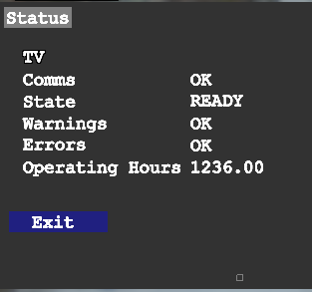
Ext VMS Operation – Status – Bit Displays
TV – Daylight Camera
Displays communication status and current state.
Also displays any warnings or errors

Slide 21
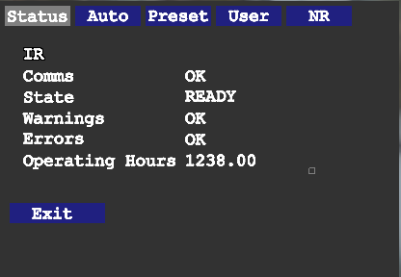
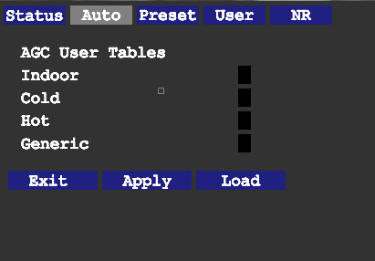
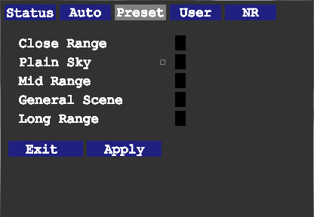
Ext VMS Operation – Status – Bit Displays
Status page has general information on the state of the TI
Auto
Can be utilised to set AGC control automatically for differing environments.
Presets
These are internal camera presets for differing scenarios

Slide 22
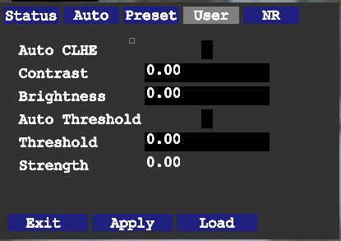
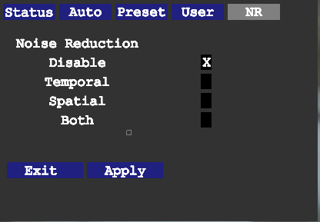
Ext VMS Operation – Status – Bit Displays
User presets for Contrast, brightness and thresholds
NR – Noise reduction
Can be utilised to fine tune the picture from the TI.

Slide 23
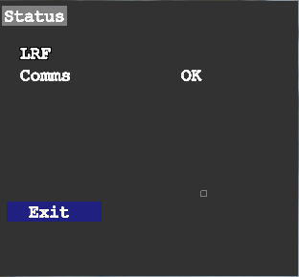
Ext VMS Operation – Status – Bit Displays
LRF
Displays communication status of the unit.

Slide 24
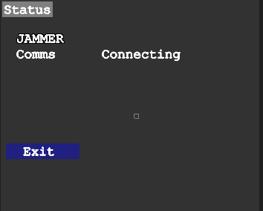
Ext VMS Operation – Status – Bit Displays
Jammer
Displays communication status of the unit.

Slide 25
Software application
Questions?

Slide 26
Ext VMS Operation – Template Page
Put something in here…..

